Slide 1
MEASURING AND FUNDING THE INNOVATIVE CAPACITY.
FORUM ISTANBUL 2019
Mustafa Gözalan

Slide 2
GLOBAL INNOVATION INDEX COMPILATIONS
There are several reputable organizations conducting, reviewing and compiling innovation indexes around the world.
None of these studies are free from errors but may represent a source of ‘benchmark’ for Turkey’s performance with an analytical guidance.
The most commonly used studies are;
  IMD – World Competitiveness Yearbook
  WEF- The Global Competitiveness Report
  EU- European Innovation Index
  INSEAD – Global Innovation Index
Although the objectivity might be a critic, the compilations of Composite Science and Technology Innovation Index of KISTEP, (Korea Institute of S&T Evaluation and Planning) is also a must-read analysis of a country’s position in the global innovation competitive landscape.

Slide 3

GII
96
49
52
62
55
43
72
Rankings of Turkey
among 130 Countries
GII= 43
Input = 62
Output= 43
KPI’s
52
43
39
SOURCE: Cornell University, INSEAD & WIPO

Slide 4
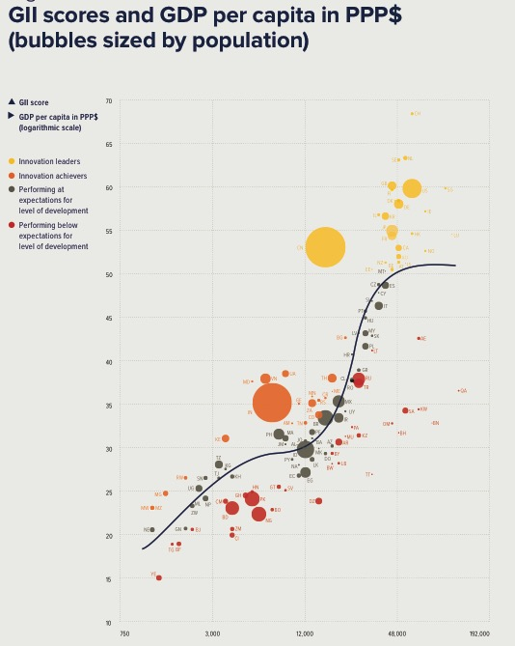
WHERE DOES TURKEY STAND ?
Score for Innovation index
PPP adsted GDP per capita

Slide 5
WHERE DOES TURKEY STAND ?
Very Strong Correlation
2X Innovation = 2X GDP
Turkey
Score for Innovation index
PPP adsted GDP per capita

Slide 6
HIGHLIGHTS OF GII

Slide 7

COMPOSITE S&T AND INNOVATION INDEX
Turkey

Slide 8
HIGHLIGTS OF COMPOSITE INDEX

Slide 9
RELATIVE STRENGTS AND WEAKNESS
Relative Weakness ! ! !
Relative Strengths ! ! !
GERD % of GDP
Size of the economy requires more R&D Funding
GERD Volume
Absolute amount of RD spending is not BAD at all
BERD % of GDP
Participation to R&D by Business is LOW..
Opportunity Driven Entrepreneur activity
Ranked 4 / over 35 OECD
Access to Funding
Market sophistication very low, non existing venture capital activity.
BERD financed by Government
Number 5 in the OECD countries
Market Capitalization
Market value very LOW !
Total Researchers
Ranked 10 / over 35 OECD countries, albeit low citations and patents
ICT service / Tech exports
Ranked 122 over 130
Monetary data ($) PPP adjusted

Slide 10
WHAT ARE WE MISSING IN THIS GLOBAL GAME
Dead End in our Eye Sight..!!!
HOW TO SPARK THE PLUG !
Public Private Participation.
Tax and other incentives.
Less and Friendly Regulation.
Avoid the Proxies and aggressively support the disruption.
Advance Purchase Commitments
TVF is the right place to start
SPAC
Special Purpose Acquisition Company
BDC
Business Development Company
Diaspora Bonds
Sovereign Micro Funding
Junk Bonds
Student Loan Market / Securitization
NEED FOR ENABLING PLATFORMS
Enabling Environment ( Simple entry / simple Exit / high Liquidity / tax friendly..
  SAFE : Simple Agreement for Future Equity
  TOKENIZATION: Emerging securitization
Crowd/Micro Financing
Cooperative Banking
Islamic Financial Tools
Takaful, Retakaful, Sukuk, Stocks
Super Nova Companies
High Multiplier Co.
Market Inefficiencies
Waste Management, Payment Processing, SCM

Slide 11
THANK YOU

